Slide 1
Requirements Engineering Process
Assoc. Prof. Dr. Rodina Ahmad
Software Engineering
WKES 3202

Slide 2
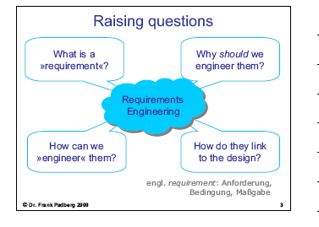
Raising Questions

Slide 3
IEEE: »Requirement«
(2) A condition or capability that must be met or
possessed by a system or system component
to satisfy a contract, standard, specification, or
other formally imposed documents.
(1) A condition or capability needed by a user to
solve a problem or achieve an objective.
(3) A documented representation of a condition
or capability as in (1) or (2).

Slide 4
Why should we engineer requirements?
the task is important:
the requirements are the basis for the downstream development
the requirements must be correct and complete in order to build the right software product
errors in the requirements are costly
to a large extent, development team communicates with the customer via requirements

Slide 5
Why should we engineer requirements? (cont.)
the task is difficult:
the reqs are often unclear in the beginning
projects must handle large numbers of reqs
the task is recurring:
every project must handle reqs, all the time
we can no longer do reqs "ad-hoc" but need
a systematic approach – that is, engineering

Slide 6
IEEE: »Software Engineering«
...is the application of a systematic, disciplined, quantifiable approach to the development, operation, maintenance, and retirement of software, that is, the application of engineering to software

Slide 7
IEEE: »Requirements Analysis«
(1) The process of studying user needs to arrive at a definition of system, hardware, or software requirements.
(2) The process of studying and refining system, hardware, or software requirements.
(1) studying user needs
(2) digging deeper into the reqs
Standard Glossary of Software Engineering Terminology (ANSI/IEEE Standard 610.12-1990)

Slide 8
Analysis versus design
clearly distinguish between "what" software to develop and "how" to make it work
this distinction is indispensable for today's large systems
analysis is about the software's functionality and its properties – not about technical solutions or even implementations

Slide 9
Business Process Analysis

Slide 10
Business process analysis
Your customer wants to do business. Surely, she thinks in terms of her business and not your point of view. So, as a software analyst, your job is :
Study your customer’s application domain.
Learn your customer’s business language
Find out what her business processes look like and be able to model them

Slide 11
Business process analysis (b)
to find out which business steps your customer wants to keep or change;
to find out which business steps your customer wants to support by software.
This is often difficult and time-consuming, but inevitable in order to meet your customer's needs.

Slide 12
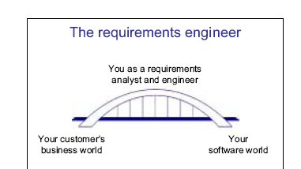
Your Task

Slide 13
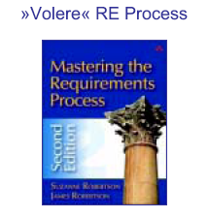
Requirements Engineering Process

Slide 14
Rationale for up-front RE
“We must know exactly what to build before we can build it “
the classical engineering viewpoint
makes sense – in general
also results in "design before coding"
leads to the waterfall software process

Slide 15
The Volere Requirements Process

Slide 16
Volere
the dictionary tells us: (ital.) volere means
»to want« »wollen«
»to wish« »mögen«
the RE process is about finding out what
the customer wants the product to be”

Slide 17
Volere Requirements Process
Customer
1. Project
Blastoff
Product Use and Evolution
Requirements Reuse
Work
Domain Knowledge Reusable Requirements
Design
and Build
Prototype the Requirements
2. Trawl for Requirements
Requirements Template
Requirements Specification
Review the Specification
4. Write the Requirements
3. Quality Gateway

Slide 18
Step 1: »Project Blastoff«
Customer Needs
Customer
Main Activity: outline the business context of the project
Main Output:
+ work context diagram
+ project goals
Project Blastoff
Work process

Slide 19
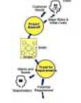
Step 2: »Trawl for Requirements«
Learn the Work
Determine Product Scope
Do Event Reconnaissance
Ask Clarification Questions
Main Activity:
analyze the business
processes that the software
must support
Main Output:
+ process descriptions
+ potential requirements for
the software
this is the most laborious
and comprehensive RE step

Slide 20
Step 3: »Write the Requirements«
3.1 Identify Potential Requirements.
3.2 Identify Functional Requirements
3.3 Identify Composite Requirements
3.4 Formalize Requirements
3.5 Formalize System constraints
3.6 Identify Nonfunctional Requirements
3.7 Write Functional Fit Criteria
3.8 Write Nonfunctional Fit Criteria
3.9 Define Customer Value
3.10 Identify Dependencies and Conflicts
Main Activity:
cast the requirements and
the other analysis results
into a structured form
Main Output:
+ formalized potential
requirements for the
software
+ the initial specification
document

Slide 21
Step 4: »Quality Gateway«
Review Requirements Fit Criteria
Input: Formalized Requirements, System Constraints
Output: Req Questions, Constraints Questions
Review Requirements Relevance
Input: Requirements Specification , Requirements Template
Output: Accepted System Constraints
Review Requirements Viability
Input: Strategic Plan for Product
Review Requirements Completeness
Identify Gold-Plated Requirements
Input : Requirements Specification
Output: Rejected Requirements, Requirements Questions
Output: Gold Plated Requirements
Input: Fit Reviewed Requirements , Requirements Template
Main Activity:
ensure a high quality of the
requirements
Main Output:
+ complete and accurate
individual requirements
+ the complete specification

Slide 22
Step 5: »Build Prototype«
Plan the Prototype
Prototyping opportunity
Build Prototype
Requirements Specification
Evaluate the Prototype
Input: Product Scope
Output: Potential Requirements

Slide 23
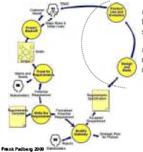
Step 6: »Product Use«
Main Activity:
field usage of the
software
Main Output:
new customer
needs

Slide 24
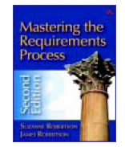
Volere Step 1: Project Blastoff

Slide 25
Project Blastoff
also known as "kickoff" or "initiation"
explore, understand, and outline the business context of the project
provides the basis for the detailed analysis of business processes and reqs
requires a lot of communication with the client and customer

Slide 26
Blastoff – Deliverables
a) Purpose of the
project.
b) The scope of the
work.
c) The stakeholders.
d) Constraints.
e) Names.
f) Relevant facts and
assumptions.
g) The estimated cost.
h) The risks.
i) Go/no-go decision.

Slide 27
Purpose of the project
a short, quantified statement of what the product is intended to do and what advantage it brings to the business
explains why the business is investing in the project and the benefit it wants to achieve
justifies the project
the project goal is the highest-level requirement

Slide 28
Running Example
Your customer, the County Highway Dept., tells you:
Roads freeze in winter, and icy conditions cause road accidents that kill people. We need to be able to predict when ice will form on a road so we can schedule a de-icing truck to treat the road in time. We expect a new system to provide more accurate predictions of icy conditions. This will lead to more timely de-icing treatment than at present, which will reduce road accidents. We also want to eliminate indiscriminate treatment of roads, which wastes de-icing compounds and causes environmental damage.
Robertson p. 42

Slide 29
Project goals (1)
Roads freeze in winter, and icy conditions cause road
accidents that kill people. We need to be able to
predict when ice will form on a road so we can
schedule a de-icing truck to treat the road in time.
We expect a new system to provide more accurate
predictions of icy conditions. This will lead to more
timely de-icing treatment than at present, which will
reduce road accidents. We also want to eliminate
indiscriminate treatment of roads, which wastes
de-icing compounds and causes environmental damage.

Slide 30
Project goals (2)
Purpose:
"accurately predict road freezing times and timely schedule the de-icing treatment"
Benefit:
reduce road accidents
Purpose:
"eliminate unnecessary treatment of roads"
Benefit:
save money on winter road maintenance and reduce damage to the environment

Slide 31
Work Scope

Slide 32
Scope of the work
"the work" means the business area affected by the installation of your product
you must first understand and scope the business area, then the future product
you need to identify the conceptual domains that are relevant in this business context
you need to identify the external systems that the work interfaces with

Slide 33
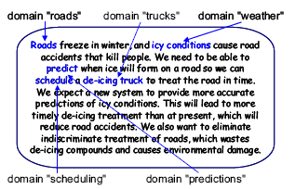
Relevant domains

Slide 34





Systems in the domains (1)
domain "weather":
weather forecasting services
weather stations owned by the customer
suppliers of thermal maps
(temperature differentials along the roads)
domain "roads":
the county's road engineering dept.
(builds and maintains the roads)
domain "trucks":
the county's truck depot

Slide 35

Systems in the domains (2)
domain "scheduling"?
domain "predictions"?
these domains are part
of "the work"!

Slide 36
Work context diagram
a simple diagram that shows the scope of the customer's business area ("the work")
the diagram depicts adjacent systems and the flow of information between the systems and "the work"
coarse-grained
the software to be built eventually becomes part of "the work"

Slide 37
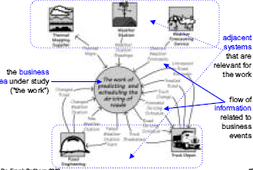
Work context diagram (p. 71)

Slide 38
Information Flows (1)
input from an adjacent system – triggers a
business event
Business events are things that happen and in turn make the work respond.
Hey! We built a new road from Stilton to Wensleydale. We put a weather station 43 kilometeres from Stilton. The road….
Changed Road
The Work
Road Engineering Dept

Slide 39
Information flows (2)
output to an adjacent system – part of the
response to a business event
Find out the business events from the stakeholders.
Road De-icing Schedule
The Work
Truck Depot

Slide 40

Information flows (3)
output to an adjacent system – triggered by
an internal timing event (this is a business event)
Its time to produce the de-icing schedule for the truck depot
Road De-icing Schedule

Slide 41

Information flows (4) (p. 86)
request and response to and from a cooperative adjacent system – as part of processing a business event
The Work
Thermal
Mapping
Supplier

Slide 42
Cooperative adjacent system
provides data upon request during the processing of a business event
that is, might appear as part of "the work," but actually is a separate, independent system
Process
Store Data
Adjacent
System
Process
Coorperative Adjacent System

Slide 43
Business events
Event | Information
Weather Station transmits reading | Weather Station Readings
Weather Bureau forecasts weather | District Weather Forecasts
Road engineers advise changed roads | Changed Road
Road Eng. installs new weather station | New Weather Station
Road Eng. changes weather station | Changed Weather Station
Time to test weather stations | Failed Weather Station Alert
Truck Depot changes a truck | Truck Change
Time to detect icy roads | Road de-icing Schedule
Truck treats a road | Treated Road
Truck Depot reports problem with truck | Truck Breakdown Amended de-icing Schedule
Time to monitor road de-icing | Untreated Road Reminder

Slide 44
Business events (2)
have a total of 11 business events
...but 13 information flows?!
one particular business event ("Truck Depot reports problem with truck") involves two different information flows ("Truck Breakdown" and "Amended De-icing Schedule")
one particular information flow ("Thermal Maps") is to a cooperative adjacent system ("Thermal Mapping Supplier") and, hence, does not trigger a business event

Slide 45
Stakeholders
the dictionary tells us:
stake = a share or interest in a business or a given situation
stakeholder = a person or organisation with a legitimate interest in a given situation, action, or enterprise
wikipedia tells us:
corporate stakeholder = a person, group,
organization, or system who affects or can be
affected by an organization's actions

Slide 46
Stakeholders
in RE: replace "organization's actions" with "system [or software] requirements"
Robertson (p. 45): stakeholders are the"source of requirements“
Client ≠ Customer ≠ User
three important groups of stakeholders in RE:
client: pays for the development of the software product
customer: buys the software product
user: actually uses the software product

Slide 47
Stakeholders : example
client = Saltwork Systems, represented by chief executive Mack Andrews
customer = Northumberland County Highways Dept., represented by director Jane Shaftoe
potential additional customers = other counties in the UK
users = highways dept. clerks; truck depot supervisors; road eng. dept. supervisors

Slide 48
More stakeholders
other potential stakeholders in RE:
managers
consultants
technical experts
marketing people
lawyers
negative stakeholders (they do not want the product)

Slide 49
Blastoff – More deliverables (1)
constraints (solution and project)
Are there any existing technical solutions that must be used?
How much time and money are available?
names, relevant facts, assumptions
Is any special terminology used by this part of the organization?
Are there any facts or assumptions that may affect the outcome of the project?
special terminology typically is captured in a "glossary"

Slide 50
Blastoff – More deliverables (2)
estimated project cost
short analysis of the main risks faced by the project
go/no-go decision
Is the project viable?
Does the cost of producing the product make it worthwhile?
Do you have enough information to proceed with the requirements activity, or should you ask for more time to learn more?
connects to project management

Slide 51
Costing and Go/No-go
at this stage, there is too little information to sensibly estimate the software cost – but it may be possible to estimate the cost of the reqs analysis phase
the go/no-go decision often is made just for the reqs analysis phase
in today's contracts, the client usually has several "exit points" for the project

Slide 52
SafeHome example
We would like to enter the market for home security systems by building a microprocessor based system that would protect against and/or recognize a variety of undesirable "situations“ such as illegal entry, fire, flooding, and others.
The product, tentatively called SafeHome, will use appropriate sensors to detect each situation, can be programmed by the homeowner, and will automatically telephone a monitoring agency when a situation is detected.

Slide 53
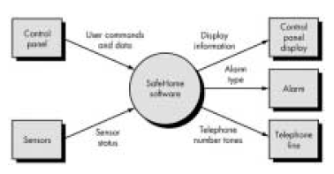
SafeHome context diagram

Slide 54
Event-Driven Use Cases
1.The scope of the work is agreed to by all parties at the blastoff {define the work area and the adjacent system}
2. Adjacent systems supply data to the work or receive data from the work.
3. Business events happen in the adjacent systems- like the demand for work. {cause a flow to or from the work}
4.The response to the business event is a business use case. It includes all the processes and data needed to make the correct response.

Slide 55
Process to follow
5. The analysts study each business use case, often by writing a scenario {with the help of stakeholders}
6. The stakeholders and analysts decide the optimal product to build
7. Product functionality is described and confirmed using a product use case scenario.
8. Analyst writes the requirements for the product

Slide 56
Context of the work
The work to be studied must include anything that can be affected by your product.
The work context includes anything that you are permitted to change and anything that you need to understand to decide what can or should be changed
The farther away from the anticipated automated system you look, the more useful and innovative your product is likely to be.

Slide 57
Why business events and business use cases are a good idea
By looking not at the inside, but from the outside, we get a far clearer idea of the most functional way of partitioning the work
The product-centric way of looking at the problem means that you miss opportunities for improving your product by branching into other parts of the work.
It discourages the analysts from asking, “But why is this like it is?” This failure , in turn, leads to technological fossils being carried from one generation of a product to the next.

Slide 58
Business use cases
It is the most convenient unit of work to study
You can identify one or more stakeholders who are expert in each business use case.
The work’s response to the business event is to continue processing until all active tasks have been completed and all data retrieved or stored.
An adjacent system might be an organization, an individual ,a computer system or other pieces of technology or a combination of any of these.
Active adjacent systems are humans. They initiate business events with an objective mind.

Slide 59
To get the best picture, get inside the brain of the adjacent system.
E.g. Why does the bank customer want the cash? Does she intend to pay her electricity bill? What else does she do?- understanding the business
By understanding the brain of the adjacent system, we are able to produce a better product.
Autonomous system is some external body { like govt, company} who is not directly interacting with work. It usually sends or receives a one-way data flow from/to the work.
Cooperative adjacent systems are computerised system like a database, operating system or other systems.

Slide 60
Business use cases and Product use cases
Once you understand the correct work of the business use case, determine the scope of the product.
After the study, analysts and the stakeholders decide how much of the business use case is to be handled by the proposed product – product use case
Whatever is immediately outside the scope of the product becomes the actor- who manipulates the functionality of the product use case within the product.

Slide 61
Volere Step 2: Trawling for Requirements

Slide 62
Trawling (1)
the analyst seeks to understand the desired functionality of the future software
to this end, he must analyze the business processes that the software must support
he describes and models the business processes, then "trawls" the models for requirements

Slide 63
Trawling (2)
starting point are the results from the blastoff:
work context diagram
table of business events
list of stakeholders
main output:
business process descriptions
potential requirements
concept for partitioning: business use case

Slide 64
Role of requirements analysts
Observe and learn the work, and understand it from the point of view of the user
Interpret the work – analyst must filter the user’s description to strip away the current technology
Invent better ways to do the work. - see the essence of the work, he can interpret what the product must do to satisfy that part of the work
Record the results in the form of a stakeholder-understandable requirements specification and analysis models.

Slide 65
Business use cases
the scope of "the work" is bounded by the communication with the adjacent systems
business events happen in the adjacent systems (or, are time-triggered)
the data flow resulting from a business event reaches "the work"
"the work" responds to the event with pre-planned actions = a business use case
that is, business use cases link to events

Slide 66
Use case – original definition
a sequence of interactions between an actor (or actors) and a system triggered by a specific actor, which produces a result for an actor
I. Jacobson, M. Christerson, P. Jonsson, G. Overgaard:
Object-Oriented Software Engineering – A Use Case
Driven Approach (ACM Press, 1992)

Slide 67
Current and to-be processes
the first goal is to understand the work as-is
models help by providing different views of the business processes
ask questions about...
what the analyst doesn't know yet
what the analyst doesn't understand yet
what the business people don't know yet
study the current work, but also possible improvements to it as a secondary goal

Slide 68
Trawling – Important techniques
use case workshops
interviews
apprenticing (observing a user "in action")
studying existing documents (such as process descriptions, problem reports, work artifacts)
prototyping
diagramming

Slide 69
Volere Step 2a: Analyzing the Business Processes

Slide 70
Getting to the Essence of the Work
When trawling, much of what you hear is a stakeholder’s idea for the solution.
But what you have to focus is to identify the essence of the work: fundamental reason that the work exists.
The essence exists regardless of any technological implementation.
E.g. ATM system : the essence: withdraw money from the bank account.
Don’t rely on your stakeholders knowing exactly what they want, To make the leap forward, you have to be inventive to truly satisfy your client.

Slide 71
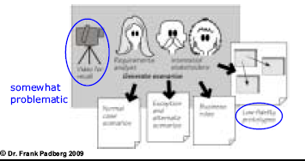
Use case workshops
the analyst works with a manageable group of stakeholders to find the scenarios for each use case
Your task: to record these actions and then use them to derive the requirements for the product.

Slide 72
Scenario
describes what is being done by the business use case as a series of steps (recall: in response to a business event)
3 to 10 steps
stakeholder-friendly description
"broad-brush picture"
stakeholders are invited to participate and revise the scenarios until they represent a consensus view of what the work should be

Slide 73
Business Scenario
BE-10: Truck depot reports problem with truck
1. Truck breaks down while on the road.
2. Truck radios the truck depot.
3. Truck depot supervisor tells the de-icing work about the truck problem.
4. "The work" reschedules trucks so as to disperse the broken truck's allocation among the remaining trucks.
5. "The work" updates the truck depot supervisor on the amended de-icing schedule.
6. Truck depot supervisor implements the new schedule

Slide 74
Kinds of scenarios
normal case scenario:
shows the actions if all goes well – that is, no mistakes and nothing unusual happens
alternative case scenario: shows alternative normal case arising from intentional choices made by the user
exception case scenario: shows the actions taken to safely rejoin the normal case after an exception occurred

Slide 75
Coming topics
Business scenarios
Product scoping
Functional requirements

Slide 76
Refreshing Questions
What is the purpose of work context diagram?
What is the main activity of “trawling for requirements”?
What are the main output of “trawling for requirements”?
What is a scenario?

Slide 77
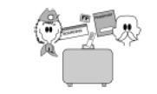
An example of scenarios derived from a business use case
Checking a passenger in for an international flight

Slide 78
Constructing the initial scenario (1)
The check-in agent tells the analyst:
"I call the next customer in line. When he gets to my desk, I ask for a ticket. If the passenger is using an e-ticket, I need the booking record locator. Most of the passengers are not organized enough to have it written down, so I ask them their name and the flight they are on. Most people don't know the flight number, so I usually ask for their destination."
checking a passenger in for an international flight
1. Get the passenger's ticket or record locator.

Slide 79
Constructing the initial scenario (2)
"I make sure I have the right passenger and the right
flight. It would be embarrassing to give away someone
else's seat or to send a passenger to the wrong
destination. Anyway, I locate the passenger's flight
record in the computer. If he has not already given it
to me, I ask for the passenger's passport. I check that
the picture looks like the passenger and that the
passport is still valid."
2. Is this the right passenger, flight, and destination?
3. Check the passport is valid and belongs to the passenger.

Slide 80
Constructing the initial scenario (3)
"If there is no frequent-flyer number showing against
the booking, I ask the passenger if he belongs to our
mileage scheme. Either he hands me the plastic card
with the FF number, or I ask him and if he wishes to
join I give him the sign-up form. We can put temporary
FF numbers against the flight record so the passenger
is credited for that trip."
4. Record the frequent-flyer number.

Slide 81
Constructing the initial scenario (4)
"If the computer has not already assigned a seat, I
find one. This usually means I ask if the passenger
prefers a window or an aisle seat, or, if the plane is
already almost full, I tell him what I have available. Of
course, if the computer has assigned one, I always ask
if it is okay. Somehow we settle on a seat and I confirm
it with the computer system. I can print the boarding
pass at this stage, but I usually do the bags first."
5. Find a seat

Slide 82
Constructing the initial scenario (5)
"I ask how many bags the passenger is checking and, at
the same time, verify that he is not exceeding the
carry-on limit. Some people are unbelievable with what
they want to carry into a fairly space-restricted
aircraft cabin. I ask the security questions about the
bags and get the passenger's responses. I print out the
bag tags and securely attach them to the bags, and
then I send the bags on their way down the conveyor
belt."
6. Ask security questions
7. Check the baggage onto the flight

Slide 83
Constructing the initial scenario (6)
"Next I print the boarding pass. This means that I have everything done as far as the computer is concerned. But there is one more thing to do: I have to make sure that everything agrees with the passenger's understanding. I read out from the boarding pass where he is going, what time the flight is, and what time it will board. I also read out how many bags have been checked and confirm that their destination matches the passenger's destination. I hand over the documents, and wish the passenger a good flight."
8. Print and hand over the boarding pass and bag tags.
9. "Have a good flight."

Slide 84
The initial scenario
checking a passenger in for an international flight
1. Get the passenger's ticket or record locator.
2. Is this the right passenger, flight, and destination?
3. Check the passport is valid and belongs to the passenger.
4. Record the frequent-flyer number.
5. Find a seat.
6. Ask security questions.
7. Check the baggage onto the flight.
8. Print and hand over the boarding pass and bag tags.
9. "Have a good flight."

Slide 85
Detailing the initial scenario
after confirming the initial scenario with the stakeholders, the analyst starts to "formalize“ the scenario using a scenario template
the analyst captures normal case, alternative case, and exception case scenarios
along the way, the analyst clarifies and rewrites the steps
all the necessary information comes from the stakeholders

Slide 86
Scenario Template
Business Event Name
Business Use Case Name and Number
Trigger
Preconditions
Interested Stakeholders
Active Stakeholders
Normal Case Steps
Alternative Steps
Exception Steps
Outcome
the data, or request for service, or temporal condition that
triggers this case
the people or systems that are doing the work in this case
the conditions that must exist before this case is valid
the desired situation after this case (see the stakeholder's
objective)

Slide 87
Template for the example (part 1)
BE: Passenger decides to check in
BUC: Check passenger onto flight
Trigger: Passenger's ticket, record locator, or identity and flight
Preconditions: The passenger must have a reservation
Interested Stakeholders: Check-in agent, baggage handling, reservations, security, immigration
Active Stakeholders: Passenger, check-in agent
Scenarios: ....

Slide 88
Main scenario : validation(a)
1. Get the passenger's ticket or record locator.
the ticket and record locator are merely means to an end – namely, to find the passenger's reservation; hence, the step gets rewritten:
.
1. Locate the passenger's reservation

Slide 89
Main scenario : validation(b)
2. Is this the right passenger, flight and destination?
turn the question into an action – namely, to ensure the condition is met; hence, the step gets rewritten:
2. Ensure the passenger is correctly identified and connected
to the right reservation.

Slide 90
Main scenario : validation(c)
2. Is this the right passenger, flight and destination?
3. Check the passport is valid and belongs to the passenger
this check is more complex and needs explanation; either add detail* or refer to the corresponding business rules; hence, the step gets augmented:
3. Check the passport is valid and belongs to the passenger

Slide 91
The enhanced main scenario
1. Locate the passenger's reservation.
2. Ensure the passenger is correctly identified and connected to the right reservation.
3. Check the passport is valid and belongs to the passenger. see procedure guidelines EU-175
4. Attach the frequent-flyer number to the reservation.
5. Allocate a seat.
6. Get correct responses to security questions.
7. Check the baggage onto the flight.
8. Print and convey the boarding pass and bag tags.
9. Wish the passenger a pleasant flight.

Slide 92
Alternative steps
4. Attach the frequent-flyer number to the reservation.
the passenger is given choices by the airline to
provide better service to him; hence, there are
alternative steps:
4.a Allow the FF number to be changed to that of a partner airline.
4.b Allow the FF number to be changed to that of a family
member, or the mileage of the flight to be donated to a
charity of the passenger's choice.

Slide 93
Exception steps (1)
5. Allocate a seat.
on occasion, the seat chosen by the passenger is not available; this is unwanted, but possible; hence, there are exception steps:
Exception 5.a
Condition: The passenger's choice of seat is not available.
Steps:
i. Record a request for a seat change by the gate agent.

Slide 94
Exception steps (2)
3. Check the passport is valid and belongs to the passenger.
on occasion, there may occur a problem with the
passenger's passport; this is unwanted, but possible; hence, there are exception steps:
Exception 3.a
Condition: The passenger produces a passport that is not his.
Steps:
i. Call security.
ii. Freeze the reservation.

Slide 95
Template for the example
[... Normal Case Steps ...]
[... Alternative Steps ...]
[... Exception Steps ...]
Outcome: The passenger is recorded as checked
onto the flight, the bags are assigned to the flight, a
seat is allocated, and the passenger possesses a
boarding pass and bag claim stubs.

Slide 96
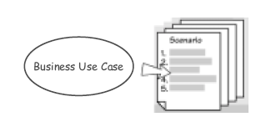
Where are we now?
each business use case is described by several scenarios

Slide 97

Volere Step 2b: Scoping the Software Product

Slide 98
Scoping
not all steps in the response to a business event can be or shall be done by a software
some business steps are done by humans (f.e., users, operators), others are done by existing systems (f.e., other software)
scoping means to decide which part of the work shall be handled by the new software

Slide 99
Scoping and analysis
the analyst must never assume what the responsibilities of the software product are
instead, the software's scope must be determined step-by-step during requirements analysis from an understanding of the work
in the end, the client decides – within the project constraints, money, feasibility...

Slide 100
Product use case
product use case = that part of a business
use case that shall be performed by the software product
for scoping, business use cases / scenarios map onto product use cases / scenarios
hence, business use case ≠ product use case

Slide 101
Check-in example: The main product scenario
Locate the passenger's reservation.
2. Ensure the passenger is correctly identified and connected
to the right reservation.
3. Check the passport is valid and belongs to the passenger.
see procedure guidelines EU-175
4. Attach the frequent-flyer number to the reservation.
5. Allocate a seat.
6. Get correct responses to security questions.
7. Check the baggage onto the flight.
8. Print and convey the boarding pass and bag tags.
9. Wish the passenger a pleasant flight.

Slide 102
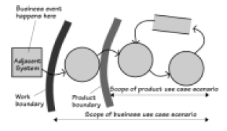
Work scope vs. product scope
thinking in terms if process diagrams, scoping
means drawing the product boundary

Slide 103
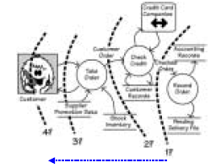
Choosing the product scope
different
product
scopes for
a telephone
ordering
system
software functionality increases – manual work decreases

Slide 104
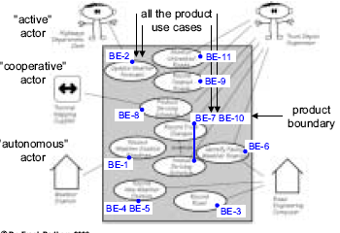
Product use case diagram

Slide 105
Business Events – Cross checking (1)
most business events just map to a product use case (BE-1, BE-2, BE-3, BE-6, BE-8, BE-9)
BE-4 RoadEngInstallsNewWeatherStation and BE-5 RoadEngChangesWeatherStation map to the same product
use case: RecordNewWeatherStation
BE-7 TruckDepotChangesTruck and BE-10
TruckDepotReportsProblemWithTruck map to the same
product use case: RecordTruckChanges
BE-11 TimeToMonitorRoadDeicing turns into product use case: MonitorUntreatedRoads

Slide 106
Cross-checking... (2)
use case RecordTruckChanges extends use case AmendDeicingSchedule – after a truck change or truck breakdown, the schedule must be adapted
actor ThermalMappingSupplier participates in use case ProduceDeicingSchedule
actor RoadEngComputer participates in use case IdentifyFaultyWeatherStation

Slide 107
Refining product use cases
during analysis, product use cases can be subdivided, merged, augmented...
this often happens when analysis reveals common sub-processes in the product use cases
leads to «extends» or «uses» relationships between use cases

Slide 108
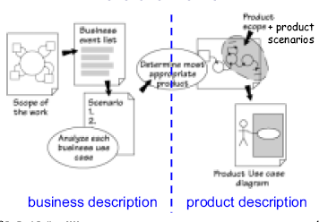
Where are we now?

Slide 109
Volere Step 2c: Identifying the Requirements

Slide 110
Functional requirements
Functional requirements describe what the product must do to carry out the work for which it is intended. They are independent of any technology used by the product.

Slide 111
Writing a functional requirement
The product shall record the new weather stations.
the product must do something...
• ...an action that contributes to the project goal
• ...stated in one, plain sentence
• ...taking a product's viewpoint
keep it short, simple, and self-explanatory

Slide 112
From scenario to requirements (fiq 7.2)
Requirement
Requirement
Use Case Scenario
1.
2.
3.
4.
Requirement
Requirement
Requirement
Stakeholder desribe the work

Slide 113
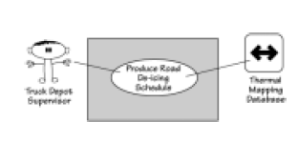
Product scenario to requirements
Truck Depot Supervisor
Produce road De-icing Schedule
Thermal mapping Database

Slide 114
Studying the scenario (1)
Produce road de-icing schedule
1. Engineer provides a scheduling date and district identifier.
2. Product selects the relevant thermal maps.
3. Product uses the thermal maps, district temperature readings, and weather forecasts to predict temperatures for each road section for the district.
4. Product predicts which roads will freeze and when they will freeze.
5. Product schedules available trucks from the relevant depots.
6. Product advises the engineer of the schedule.

Slide 115
Studying the scenario (2)
Produce road de-icing schedule
1. Engineer provides a scheduling date and district
identifier.
The product shall accept a scheduling date.
Is there anything special about the scheduling date?
"Scheduling is never done more than two days in advance"
The product shall warn if the scheduling date is
neither today nor the next day.

Slide 116
Studying the scenario (3)
Produce road de-icing schedule
1. Engineer provides a scheduling date and district
The product shall accept a valid district identifier.
What do you mean by a valid identifier? "....."
The product shall verify that the district is within the
de-icing responsibility of the area covered.
.
The product shall verify that the district is the one
wanted by the engineer

Slide 117
Studying the scenario (4)
Produce road de-icing schedule
4. Product predicts which roads will freeze and when they will freeze.
The product shall determine which areas in the
district are predicted to freeze.
The product shall determine which road sections
pass through areas that are predicted to freeze.
The product shall determine when the road
sections will freeze.

Slide 118
Studying exceptions
Produce road de-icing schedule
5. Product schedules available trucks from the
relevant depots.
What happens if no trucks are available? "....."
If there are no trucks available, the product shall
generate an emergency request to truck depots in
adjacent counties.
Explicitly state the exceptional condition

Slide 119
From work context to requirements
Figure 7.4
Feature
Work Context
Business
Event
Product
Use Case
Produce
Use case
Step
Requirement
information gathered during the
requirements process

Slide 120
Volere Step 2x: Diagramming the Scenarios
some customers and analysts prefer process diagrams over textual scenarios
diagrams can also be used for documenting and merging textual scenarios
important: model the dynamics, whether as a textual scenario or as a diagram
requirements can be identified from the diagrams the same way as from the textual scenarios

Slide 121
Variety of process diagrams
long-standing:
data-flow diagram (DFD)
control-flow diagram (CFD)
flow chart
message sequence chart
Petri net
with UML:
activity diagram
sequence diagram

Slide 122
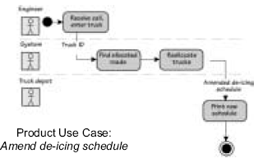
Ex: Product use case as an activity diagram p.168

Slide 123
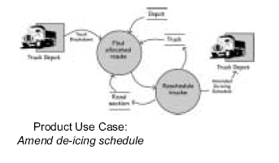
Product use case as a data-flow diagram (p. 168)

Slide 124
Coming up:
writing the specification
business data modeling
requirements quality

